Slide 1
BRK3062 - Architecting Security and Governance Across your Azure Subscriptions
Name

Slide 2
Why is Governance needed?
Pressure to digitally transform & innovate
Need for agility to reduce speed to market
Shift to DevOps
Cloud Sprawl -> Increased complexity in managing standard, accountability, compliance, consistent architecture & cost ->
at Scale

Slide 3

Traditional approach
Sacrifice Speed for Control
Developers
Cloud Custodian /
Engineers responsible for Cloud environment
Operations

Slide 4
Cloud-native governance
Speed and Control
Developers
Cloud Custodian Team
Built-in controls through policy instead of workflow
Operations

Slide 5



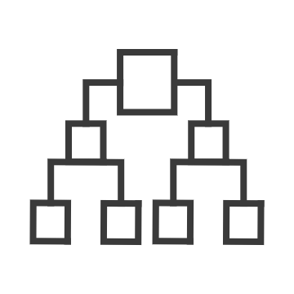
Governance for the cloud
Native platform capabilities to ensure compliant use of cloud resources
NEW
NEW
Policy
Blueprints
Resource Graph
Management Group
Cost
Real-time enforcement, compliance assessment and remediation
Deploy and update cloud environments in a repeatable manner using composable artifacts
Query, explore & analyze cloud resources at scale
Define organizational hierarchy
Monitor cloud spend and optimize resources
Control
Environment
Visibility
Hierarchy
Consumption

Slide 6
Azure Governance Architecture
providing control over the cloud environment, without sacrificing developer agility
Policy Definitions
Role-based Access
ARM Templates
Management Groups
Azure Portal
CLI
3rd party
Environment Factory: Deploy and update cloud environments in a repeatable manner using composable artifacts
Subscriptions
CRUD
Query
Azure Blueprints
Policy Engine
Azure Resource Graph
Azure Resource Manager (ARM)
2. Policy-based Control: Real-time enforcement, compliance assessment and remediation at scale
3. Resource Visibility: Query, explore & analyze cloud resources at scale
Virtual Machine
Storage
Network
…
Resource Provider

Slide 7
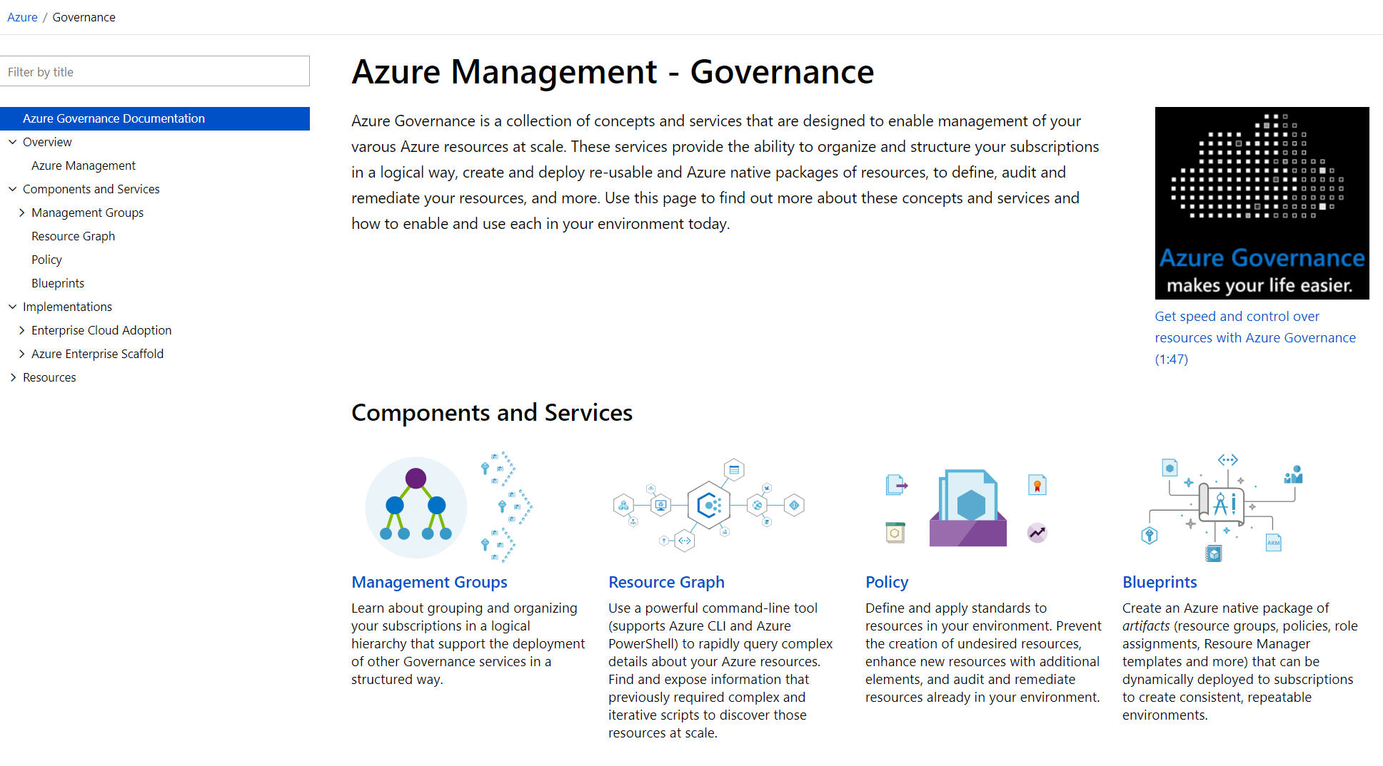
aka.ms/GovernanceDocs -or- docs.microsoft.com/azure/governance

Slide 8

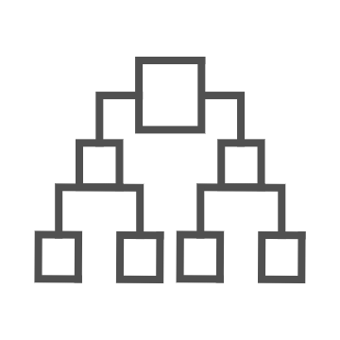
Introducing Azure Management Groups
Make environment management easier by grouping subscriptions together
Create a hierarchy of management groups that fit your organization
Apply governance controls with policies and access controls along with other Azure services
Grouping subscriptions into logical groups allow for new organization models
Inheritance allows for single assignment of controls that apply to all subscriptions
Aggregated views above the subscription level
Create a flexible hierarchy that can be updated quickly
Hierarchy doesn’t need to model the organizations billing hierarchy
Can easily scale up or down depending on the organizational needs
Azure Resource Manager (ARM) objects that allow integrations with other Azure services
Azure services:
Azure Policy
RBAC
Azure Cost Management
Azure Blueprints
Azure Security Center

Slide 9
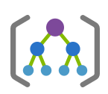

Management Group & Subscription
Modeling Strategy
Org Management Group
Prod RBAC + Policy
Pre-Prod RBAC + Policy
App A
Prod
App B
Prod
App A
Pre-Prod
App B
Pre-Prod
Microsoft Recommended
App D
Prod
Shared services
(Prod)
App C
Pre-Prod
Shared services
(Pre-Prod)

Slide 10

Azure Policy
Turn on built-in policies or build custom ones for all resource types
Apply policies to a Management Group with control across your entire organization
Real time remediation
Real-time policy evaluation and enforcement
Apply multiple policies and & aggregate policy states with policy initiative
Remediation on existing resources (NEW)
Periodic & on-demand compliance evaluation
Exclusion Scope
VM In-Guest Policy (NEW)
Enforcement & Compliance
Apply policies at scale
Remediation

Slide 11
Demo – Azure Policy
Name

Slide 12
92 of the top 100 Azure Customers use policy ASOS “..we’re now confident that all of our IaaS is hardened to our very own standards” “..continuously helping us to reduce our attack surface in our DevTest environments” Ian Margetts, Platform Lead (ALM) Leslie Lintott, Lead Platform Engineer BP “..allowed BP to obtain a better security, compliance and audit profile” “..found policies to be a game changer simply because they provide control in areas which protect compute, network, storage and various other Azure services” John Maio, Chief Architect

Slide 13

Enforce policies as part of the development process
Shift left to deliver compliant code faster
Code
Build/Test
Deploy
Operate
Monitoring
Security
Policy
Azure DevOps

Slide 14

Enforce policies as part of the development process
Shift left to deliver compliant code faster
Pre-flight
Code
Build/Test
Validation
Deploy
Operate
Policy as Code
Authoring
Policy
Security
Monitoring
Azure DevOps
Azure Policy

Slide 15
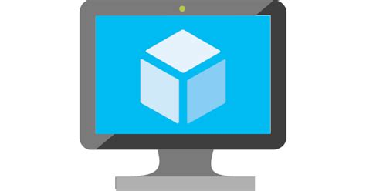

Introducing VM guest policy

Slide 16


How VM guest policy works
Policy Assignment
Policy Assignment
Compliance
Compliance
Azure Policy
Guest Configuration
Extension
VM Guest environment

Slide 17
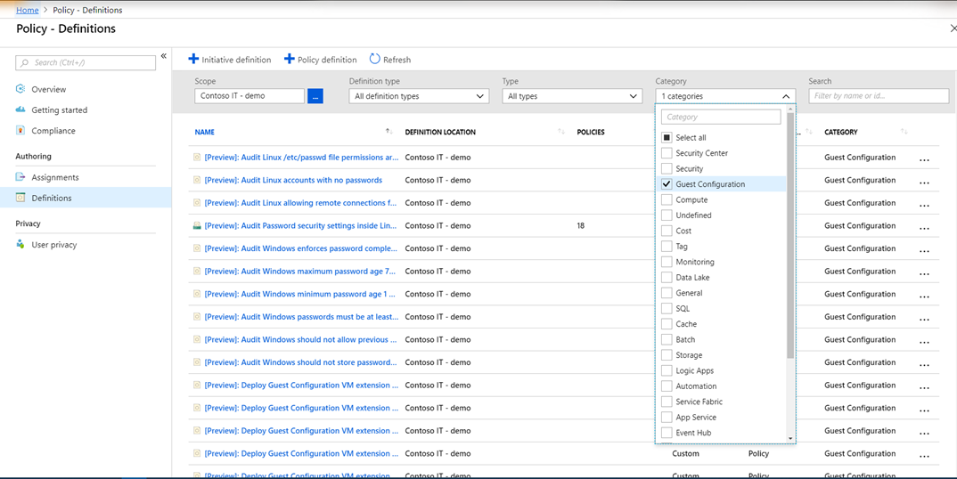
#azurevmpolicy

Slide 18
What's next for VM policy?
Drill down to non-compliant guest/workload settings
Define custom VM guest policy definitions
We need feedback from you!!!
What do you plan to audit?
What tools do you prefer?
How do you want to structure your files?
Please respond to survey and tweet #azurevmpolicy
@migreene

Slide 19
Azure Policy Best Practices
What is involved in defining a new Policy or refining an existing one?
What drives your need for Policy?
Who owns policy definitions & implementation?
Regulatory Compliance
Controlling cost
Standards & Tagging
Maintain security and performance consistency
Enforce enterprise wide design principles
“Initiative" owners like Security Architect or Cloud Architect or Cloud Engineers
Research or gather evidence on the impact of a particular configuration on a particular fundamental (like cost or security)
What-if analysis of enforcing configuration in a particular manner
Assess the current state of compliance to understand the impact of new policy and what exceptions are needed
Roll out new policy in phases
Understand the applications & teams who are non-compliant
Rollout remediation in stages via SafeDeploy practices

Slide 20

Cloud Factory
Customer Challenges
No central way to compose and enforce what goes into or made available in a subscription.
Challenging to setup foundational infrastructure
Subscription owners can modify resources and remove policies breaking best practices defined by Cloud Architects
No way to codify best practices

Slide 21



Azure Blueprints
deploy and update cloud environments in a repeatable manner using composable artifacts
Role-based access controls
Policy Definitions
Subscription A
ARM Templates
Azure Blueprints
Subscription B
Subscription C
…
compose
manage
scale

Slide 22
Demo – Azure Blueprints
Name

Slide 23


Resource Visibility
Customer Challenges
In ability to view resources and their properties across subscriptions
Query resources (without worrying about timeouts & throttling), including filtering, grouping and sorting of resources by resource properties
Need a way iteratively explore resources
Need to assess the impact of applying policies in vast cloud environment

Slide 24



Azure Resource Graph
Query, explore & analyze cloud resources at scale
Explore
Query & Analyze
Impact Assessment
Perform fast ad hoc exploration in large cloud environment
Query & analyze across all of your cloud resources at scale in seconds
Ability to assess the impact of applying policies in vast cloud environment

Slide 25
Demo – Azure Resource Graph
Name

Slide 26
Governance Roadmap- 6 to 8 months
Policy
Blueprints
Resource Graph
Management Groups
Auto-generation of aliases​
Partial RegEx support​
Multi-hop relationship​
‘What-if’ evaluation​ powered by resource graph
Sequence remediation actions
More DevOps/Policy-as-code integrations
Subscription creation as part of Blueprints deployment
Apply Blueprints to one or more Resource Groups
Sequence the deployment of artifacts
Assess (what-if) the impact\change of Blueprint on an environment
ISO, HIPAA solutions
Cross tenant queries at scale for MSP customers​
Microsoft Graph integration​
Query Explorer
Privileged Identity Management(PIM) integration and Just in Time(JIT) Capabilities
Custom RBAC Support
Custom settings for default parents of new Subscriptions and Management Groups
Tagging Support
Governance services are available in all regions. Sovereign cloud support in progress

